Slide 1
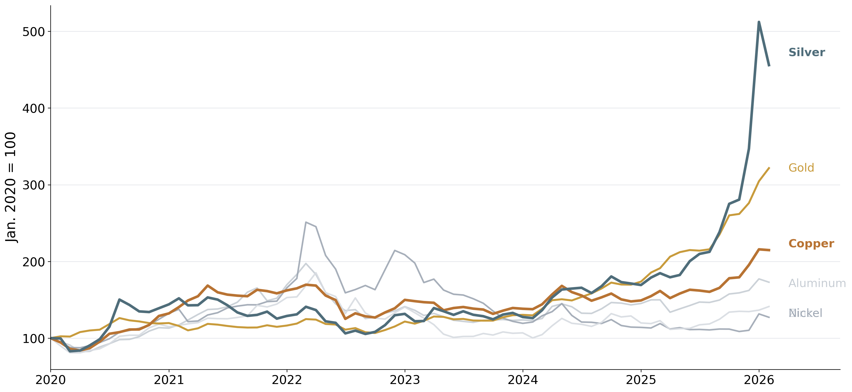
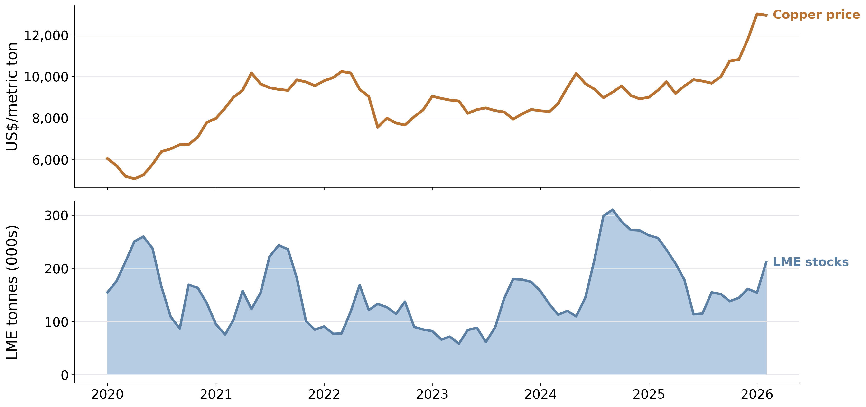
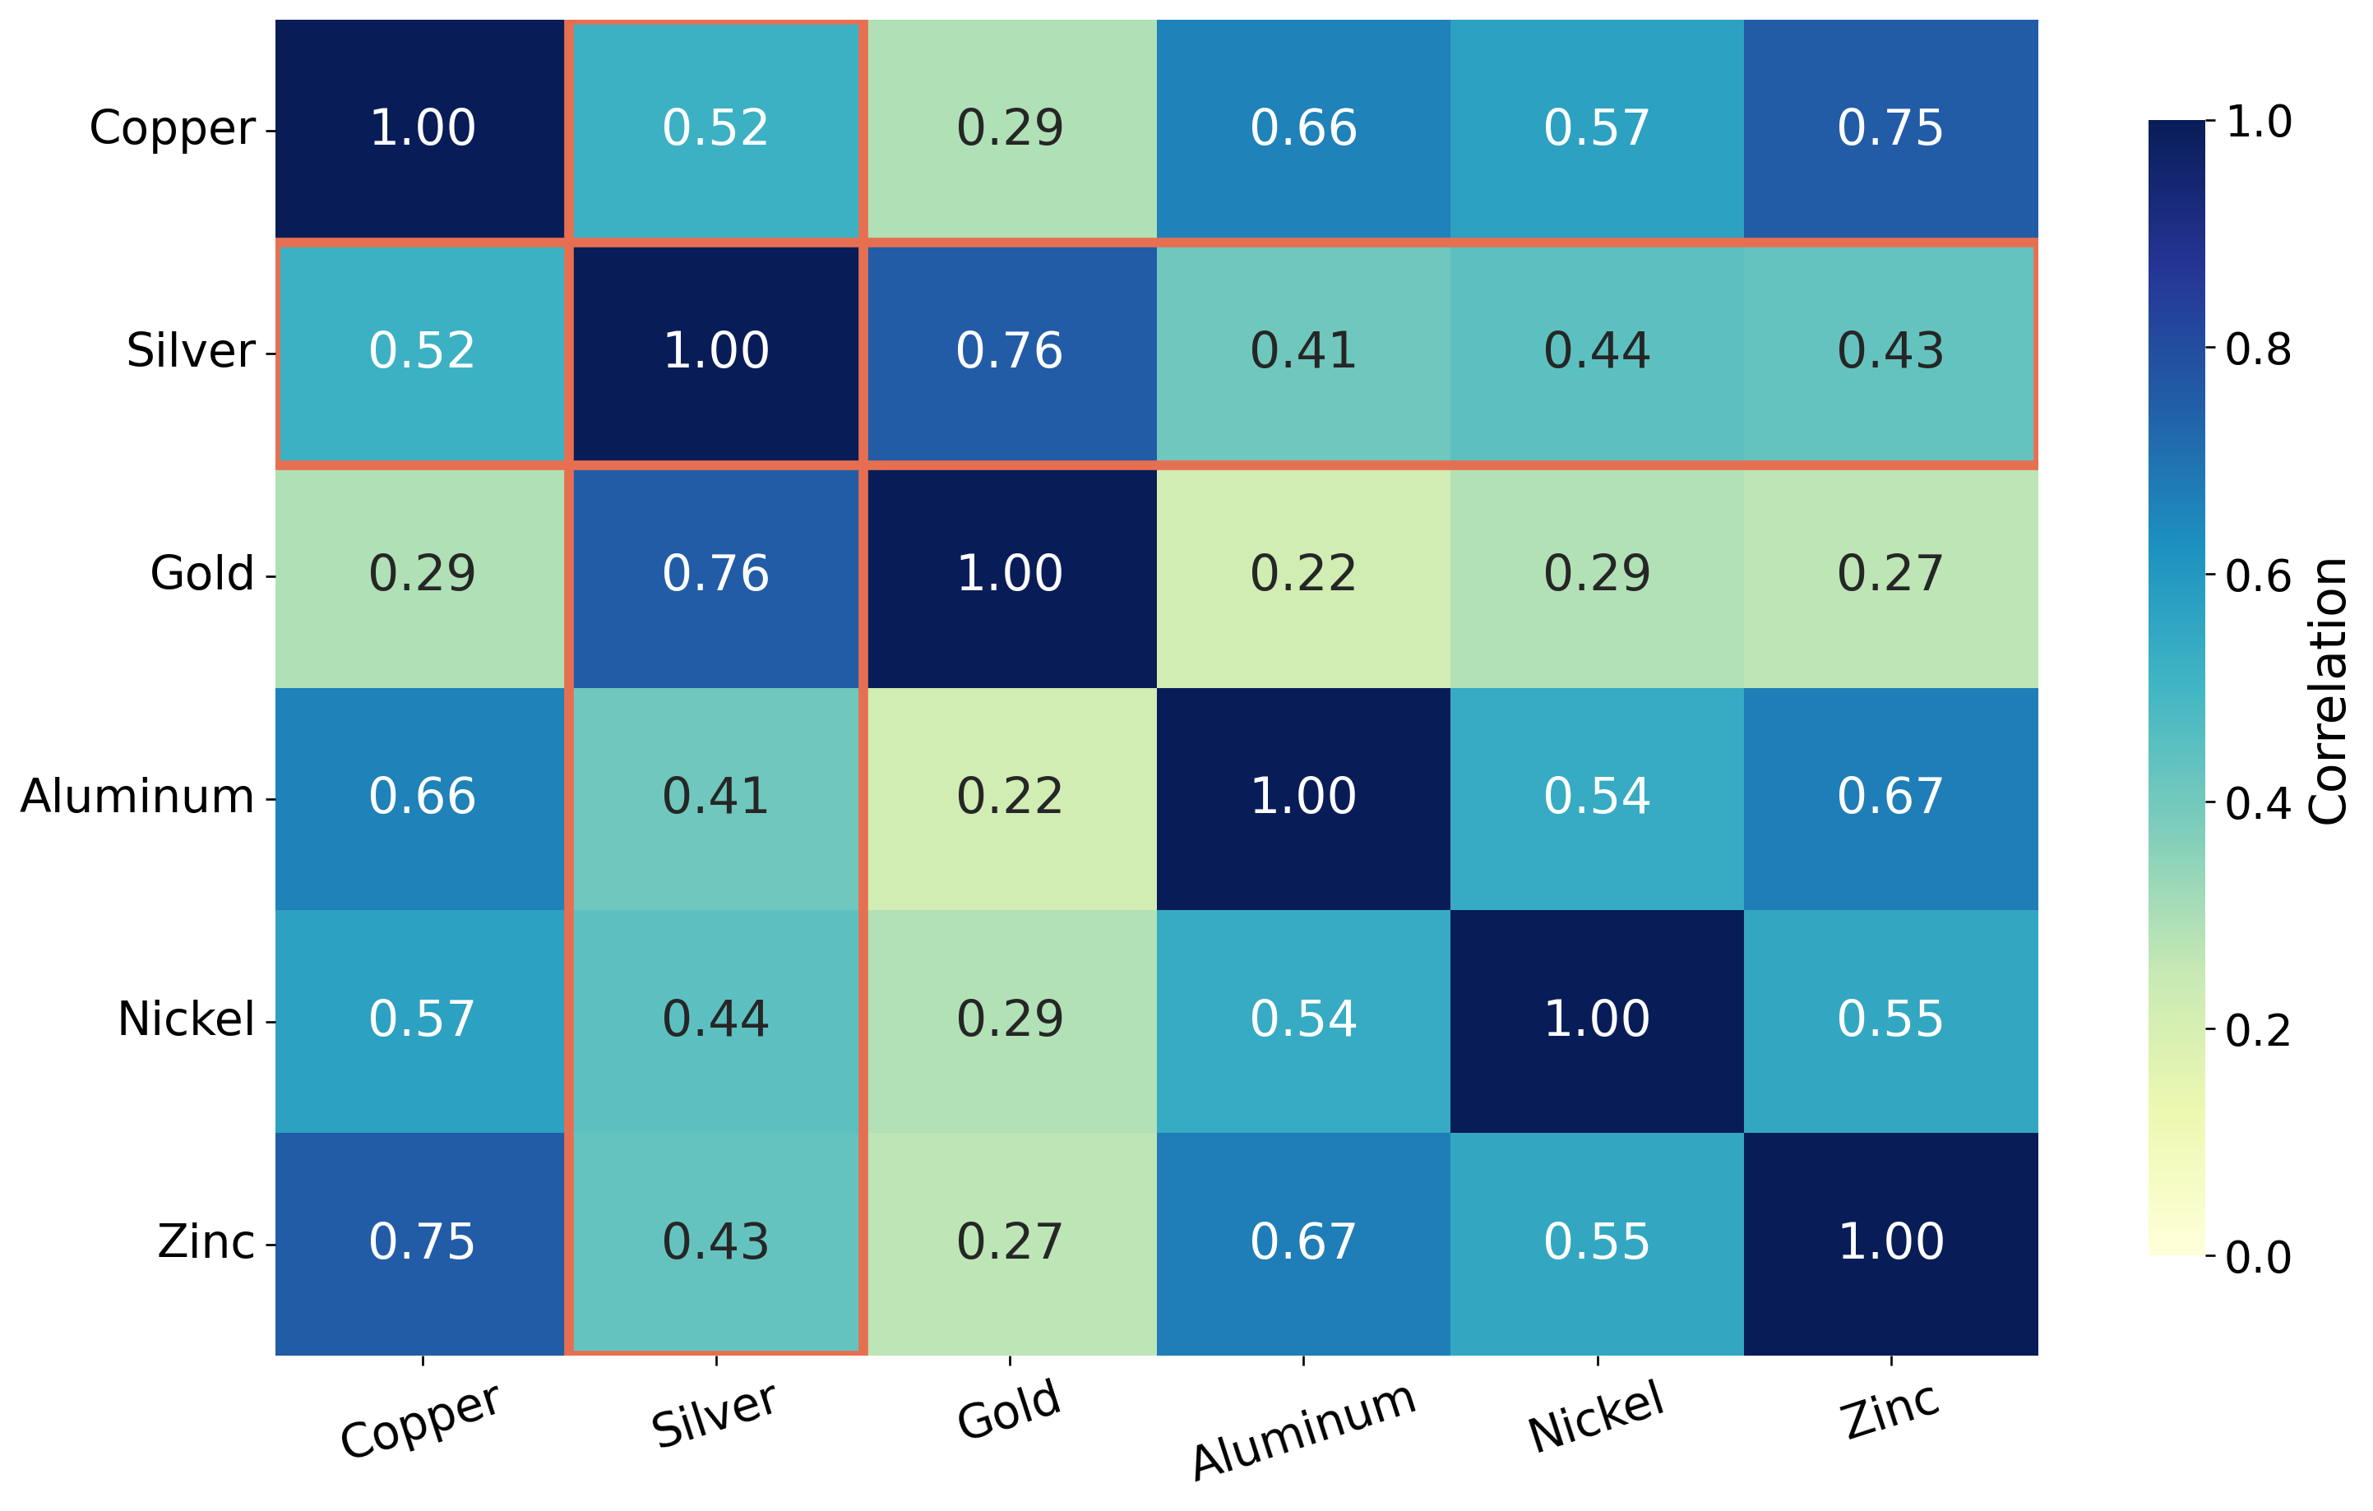
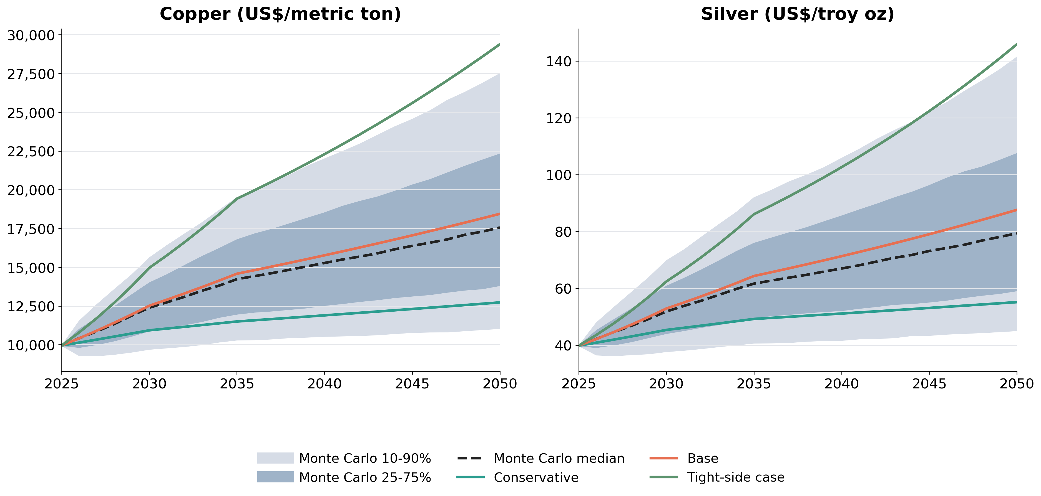
Metal Prices in Transition: Structural Tightness and the Long-Term Outlook for Copper and Silver
Amelia Kim and Mike Pelletier
Historical price evidence, inventory signals, return correlations, and long-run uncertainty bands
RESEARCH QUESTION
DATA
APPROACH
WHAT TO NOTICE
Are copper and silver entering a tighter long-run regime than other major metals?
This project separates three forces:
• short-run macro conditions
• physical-market tightening
• structural demand tied to electrification
• World Bank monthly prices for six metals, 2000–2026
• FRED and OECD macro controls
• LME copper stocks
• IEA, ICSG, Silver Institute, and USGS structural inputs
• Compare indexed price paths across metals
• Measure monthly return correlations
• Test whether copper prices rise as exchange stocks fall
• Extend the paper with scenario paths and a 10,000-draw Monte Carlo
• Copper and silver pull away after 2020
• Copper tightening shows up in inventories, not just price
• Silver remains a hybrid metal
• Long-run ranges widen over time, especially for silver
FIGURE 1
FIGURE 2
Copper and silver pulled away after 2020
Copper rose as exchange stocks fell
Indexed prices, Jan. 2020 = 100
Monthly data, 2020–2026
Source: World Bank Pink Sheet monthly prices; author calculations.
Source: World Bank Pink Sheet; LME/Westmetall; author calculations.
FIGURE 3
FIGURE 4
Silver sits between precious and industrial metals
Scenario paths sit inside widening Monte Carlo ranges
Monthly return correlations, 2010–2025
Bands show Monte Carlo ranges; lines show scenario paths
Source: World Bank Pink Sheet monthly returns; author calculations.
Source: project structural model and 10,000-path Monte Carlo simulation.
Selected sources: World Bank Pink Sheet (2026); FRED/OECD (2026); LME/Westmetall; IEA (2025); ICSG (2025a, 2025b); Silver Institute (2025a–2025c); USGS (2026).
Notes:
[Sources] - Figure 1 uses World Bank Pink Sheet monthly prices via the project workbook Metal_Panel_Long; values are indexed to Jan. 2020 = 100. - Figure 2 uses World Bank copper prices and LME/Westmetall copper stocks via Combined_Monthly_Wide. - Figure 3 uses monthly log returns for aluminum, copper, gold, nickel, silver, and zinc from the project workbook; correlations are author calculations. - Figure 4 uses LongTerm_Paths and MonteCarlo_Yearly_Percentiles from the project workbook; scenario assumptions were informed by IEA (2025), ICSG (2025a, 2025b), Silver Institute (2025a, 2025b, 2025c), and USGS (2026). - Non-trivial claims on the poster about copper electrification exposure, silver's hybrid demand profile, and structural tightness are supported by IEA (2025), Silver Institute (2025), and USGS (2026).

